Slide 1


Sentence Selection Chatbot for Ubuntu Dialog Corpus
Group 1
Aydar
Seungwoo Yoon
Chansu Park
Shinhyung Kim
Notes:
Hello. We are Team 1. We will introduct a sentence selection chatbot for Ubuntu dialog corpus.

Slide 2

Table of Contents
Motivation
Problem Description
Baseline Model
Our Model
Algorithm
Results
Conclusion
Notes:
Here is the table of contents.

Slide 3
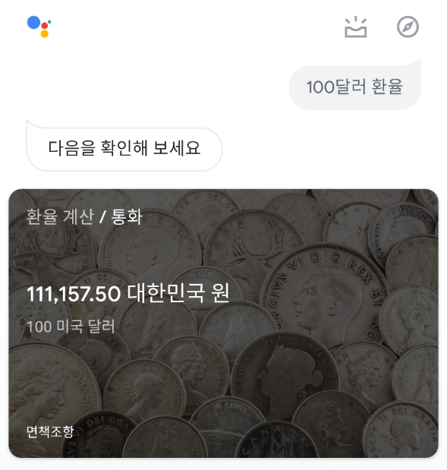
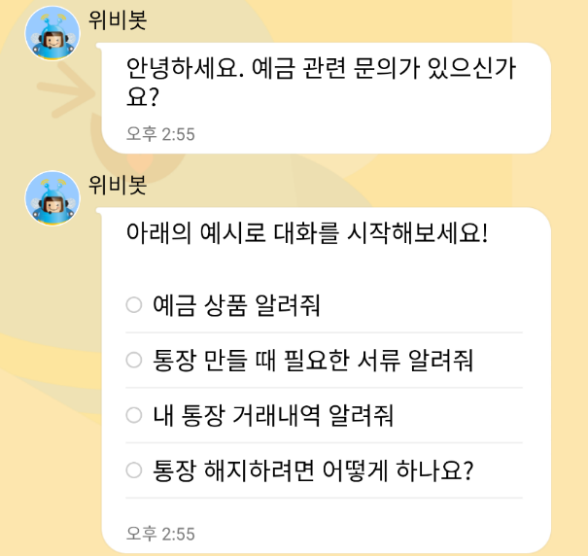
Motivation
Context/Goal recognition is important for AIs
- To interact with humans, robots have to understand what is needed for humans and have to answer/react properly
As an example, many companies launch their chatbots to solve customers requests automatically
Google Assistant
Wooribank
(Deposit/Savings part)
Notes:
Machine learning developed many breakthrough results like classifying images, object detection, and so on.
Additionally, recent researches and products have introduced AI which recognizes the context of the situation.
For the sense of the intelligent mechanics, robots have to interact with humans properly, so they have to understand what is needed for humans.
As a user-friendly product, many companies launched their chatbots to solve customers requests.
For instance, Google launched google assistant for their android phones.
Banks of Korea also introduced their own clerks and encourage users to get the answer by text dialogue.

Slide 4
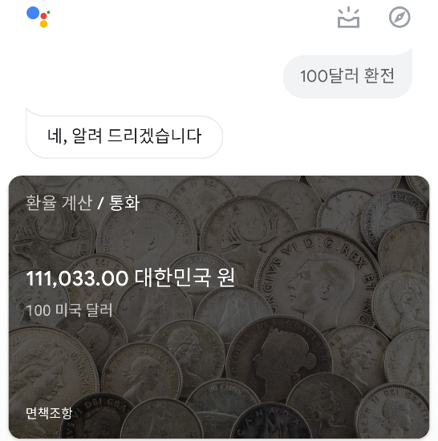
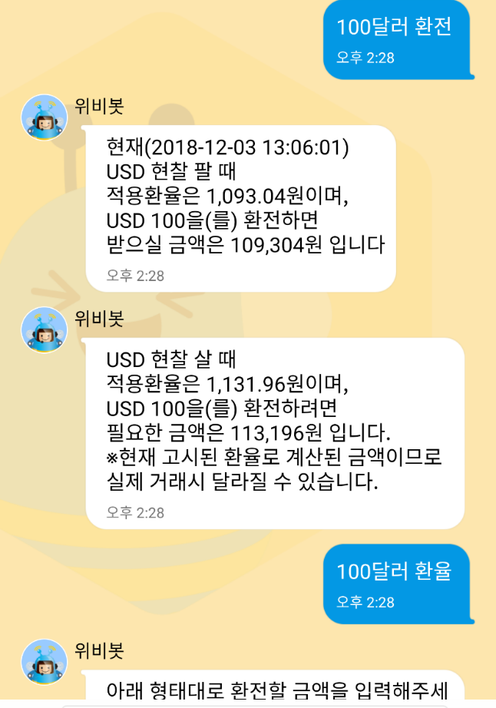
Motivation
Chatbots have to answer similarly for inputs having similar meaning.
Also, they somehow have to recognize not a full sentence, even with broken grammar or some typos/abbreviations.
Currently, some chatbots cannot do that.
← Succeed to ask 환전 (exchange), but failed to ask 환율(exchange rate)
This chatbot cannot recognize similar words.
Acts same as previous slide
Notes:
There are some properties for chatbots.
For instance chatbots have to answer similarly for inputs having similar meaning.
Even if we enter exchange rate of 100 dollars rather than the exchange of 100 dollars on the bank clerk, we want to get the amount of Korean won corresponding to 100 dollar.
Sometimes, we may enter a not-completed sentences, typos, or even abbreviations for the chatbot, but still want to get a right answer.
However, many chatbots don’t have that properties.
In this example, I succeeded to ask exchange, but failed to ask exchange rate on this clerk.

Slide 5
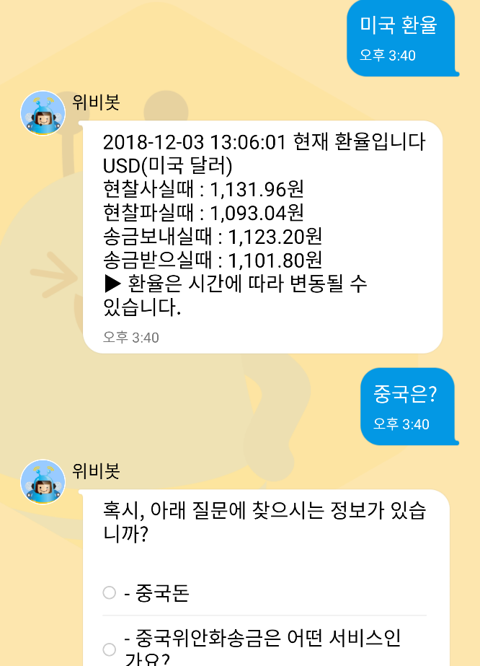
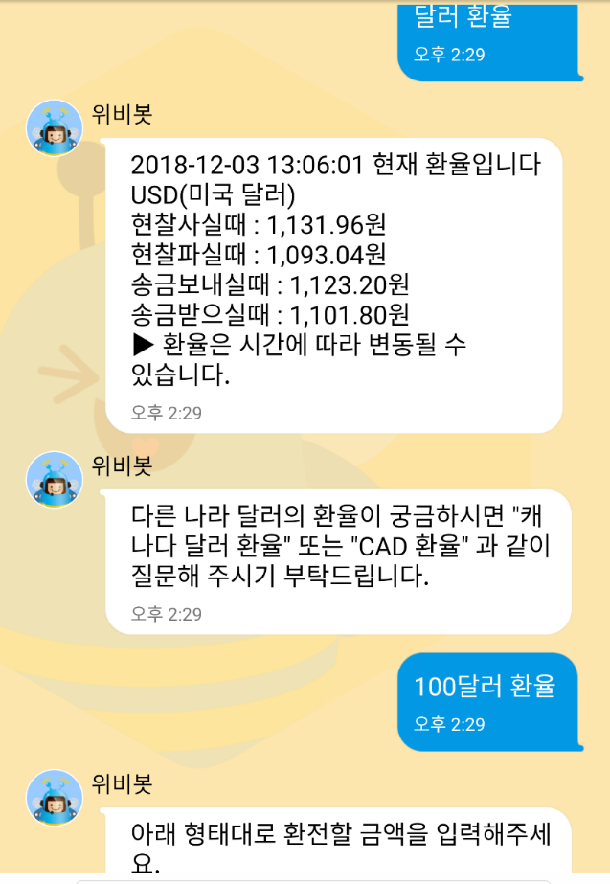
Motivation
Performance of some chatbot is awkward
← After asking 미국 환율 (dollar exchange rate), asking 중국은? (What about china?) makes failure to get an answer
← Succeed to ask 달러 환율 (dollar exchange rate), but failed to ask 100달러
This chatbot cannot recognize neither context nor similar usage.
Notes:
As the matter of context, we sometimes omit some parts of the sentence when we talk to each other.
In the left example, you can see that the clerk didn’t reply according to the context.
This clerk also failed to recognize similar usage.
When I just added 100 on my text, the clerk replied to make me follow the form of the input to exchange.
It is just a rule-based answer, so it means that this chatbot cannot recognize the similar usage.

Slide 6
Problem Description
Implement a chatbot which recognizes a two-person goal-oriented conversation including
(some) Wrong grammar
Typos
Expertized terminology (task-specific domain)
Text-based emojis
And then select right reaction from the answer pool,
which should not be hand-crafted, rule-based systems or based on hand-crafted features
Generation task: too wide possible response pool, cannot expect a proper response in most cases
Selection task: provide a limited response pool, makes chatbot to find the more accuract response
Notes:
Because of that, we decided to implement a chatbot which can take care about the two-person goal-oriented conversation with wrong grammar, typos, and even needless emoji.
Additionally, we took care about expertized terminology from task-specific domain.
What we want to do is let the chatbot selects the right reaction from the answer pool.
We originally planned to generation problem, but we turned it into the selection problem.
Generation task has too wide possible response pool which makes us not to expect a proper response in most cases.
However, selection task provides the response set, which makes chatbot to find the more accurate response.

Slide 7
Problem Description
Dataset: Ubuntu Dialogue Corpus ¹
collection of logs from Ubuntu-related chat rooms
prepared to solve an Ubuntu user’s posted problem
appropriate dataset to construct response sentence selection model for goal-oriented conversation (like bank clerks)
Details:
Task: select the next utterance from given candidate set
Candidate set will contain between 1 option that is correct and 99 options that are incorrect (for a total of 100).
Evaluation criteria: Correct accuracy of the results from Top n in 100 (n = 1, 2, 5, 10, 50)
Notes:
For this purpose, we decided to use Ubuntu dialogue corpus.
This dataset is the collection of logs from Ubuntu-related chat rooms. The goal of each data is to solve an Ubuntu user’s posted problem from the two-person dialogue.
Since our target is to implement response sentence selection model for goal-oriented conversation, we selected this dataset.
Here is the formal detail.
The given task is to select the next utterance from given candidate set with one hundered of sentences,
where the only one of them is the correct answer.
The performance of the chatbot will be decided by the accuracy of the results from Top n in 100.
(For instance, Top 1 accuracy measures the number of right responces among the whole responses.)

Slide 8
Problem Description
=================== Context ===================
User1: ugh ubuntu wotn read my ipod... i can acess the harddrive but gtkpod wont recognize it.. :(
User2: Try rhythmbox. rhythmbox reads ipods nicely in breezy
User1: SEjeff, i can put songs on my ipod through rhythmbox?
=================== Correct Answer ===================
82: No, but I got gtkpod to work perfectly with my nano and breezy
=================== Example of utterances =================== 3: I doubt they would even consider giving support...
12: no
26: I'm not sure then.
41: ok, let that finish first then
67: use /join #kubuntu-de
82: No, but I got gtkpod to work perfectly with my nano and breezy
91: I dont know, you said it was 4yrs old, I thought you may know of the bug off hand.
98: itm must be in options - somewhere
Notes:
Here is an example of the dialogue. In this dialogue, user 1 wants to recognize his ipod on the Ubuntu via gtkpod and write some songs into his device.
The proper answer in this case should be a sentence what user2 experienced on that tool.
In the dialogue, you can see some typos and wrong grammars on the user1.
In the candidate set, there are some possible simple answers like No on number 12, hesitating answer on number 26, and so on.

Slide 9
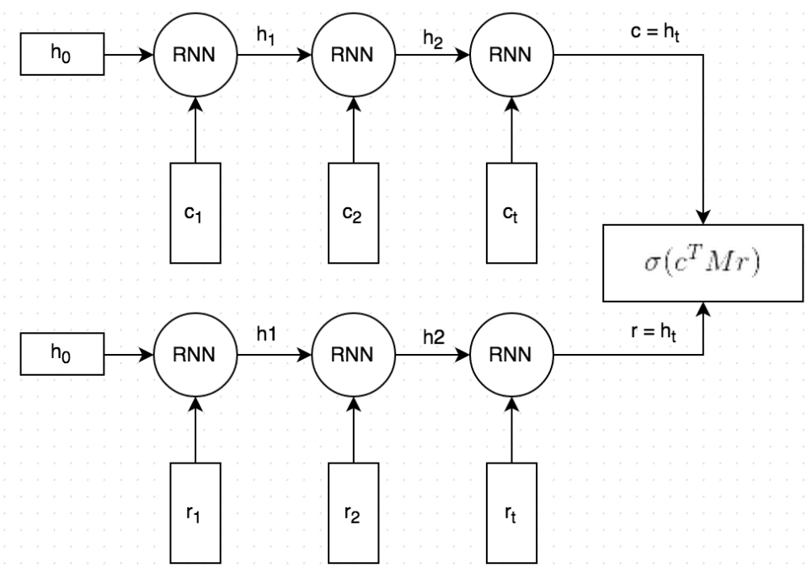
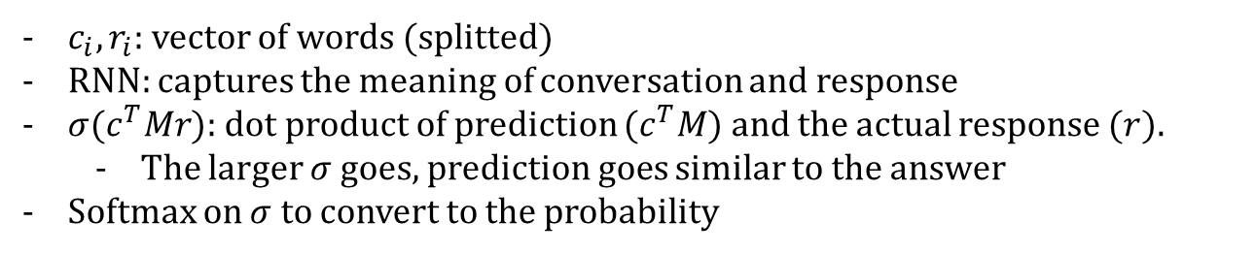
Baseline Model
conversation
probability
Softmax
100 responses
response
$c_{i}, r_{i}$: vector of words (splitted)
RNN: captures the meaning of conversation and response
$σ(c^{T}Mr)$: dot product of prediction ($c^{T}M$) and the actual response ($r$).
The larger $σ$ goes, prediction goes similar to the answer
Softmax on $σ$ to convert to the probability
Notes:
In the same paper that introduced Ubuntu dialogue corpus, they introduced their baseline model to decide the right result.
It takes conversations and responses as a vector of words, and the recurrent neural network captures the meaning of each sentences.
Then it predicts the response and compares to the actual response by taking dot product.
As the dot product gets bigger, the prediction goes similar to the answer.
Finally, it converts that value to the probability.
Then it sorts the probability for each candidates to get the top n answers.
Now we will introduce our model.

